Slide 1


December 5, 2019
An Analysis on the Global Terrorism Data
Team: AbracaData – Aishwarya B Pradeep, Danish Mir, Kanishka Jain, Nisha Dayananda, Shreeya Kotasthane

Slide 2





INTRODUCTION
“Terrorism is, in the broadest sense, the use of intentional violence, generally against civilians, for political purposes”.
Data Source: START, the National Consortium for the Study of Terrorism and Responses to Terrorism, University of Maryland, College Park
Records: 180k+ incidents
Time Period: 1970 to 2017 (except 1993)
Variables: >100
Source: Unclassified information, mainly media reports
Notes:
Source: https://en.wikipedia.org/wiki/Terrorism

Slide 3
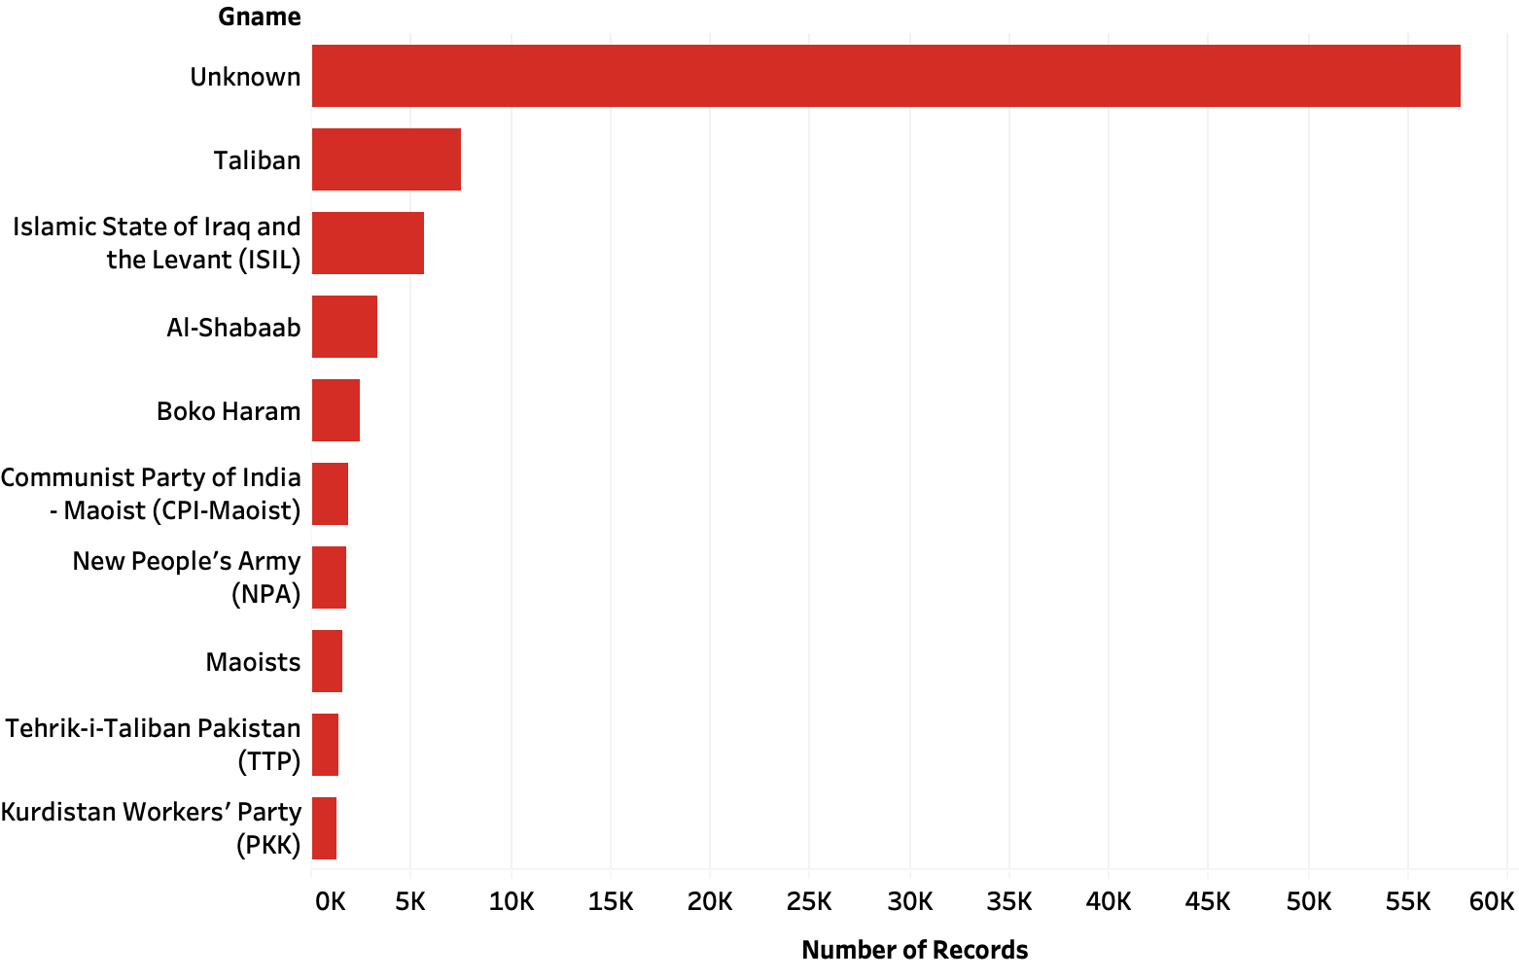
PROBLEMS
Month and Day columns have 0 as values
Redundant type/Subtype columns
“Unknown” values.
The record of incidents for the year 1993 is missing.
5. Missing values for Motive, Group responsible
6. This is a large dataset with 1,80,000+ records.
7. Property damage column had missing values and present values
had an inconsistent scale(<1mn & 1mn-1bn)

Slide 4
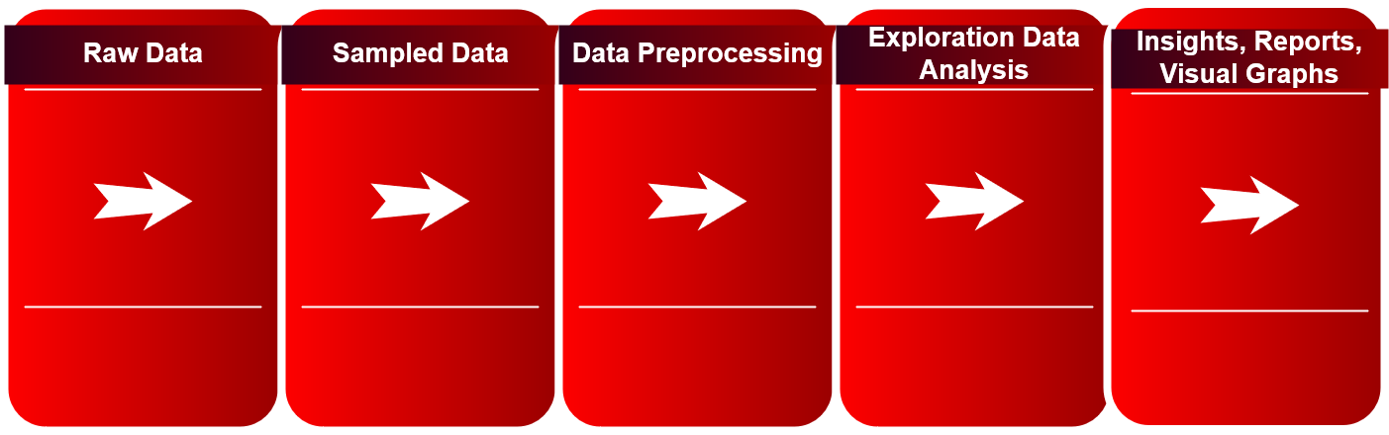
DATA PREPERATION

Slide 5



Our dataset had 180k entries and 136 columns ranging from 1970 to 2017. To reduce the size of the dataset, we created a subset of records from 2001 to 2017 and 32 columns. Dropped columns that did not assist in our analysis. Removed missing values where needed.
DATA PRE-PROCESSING

Slide 6
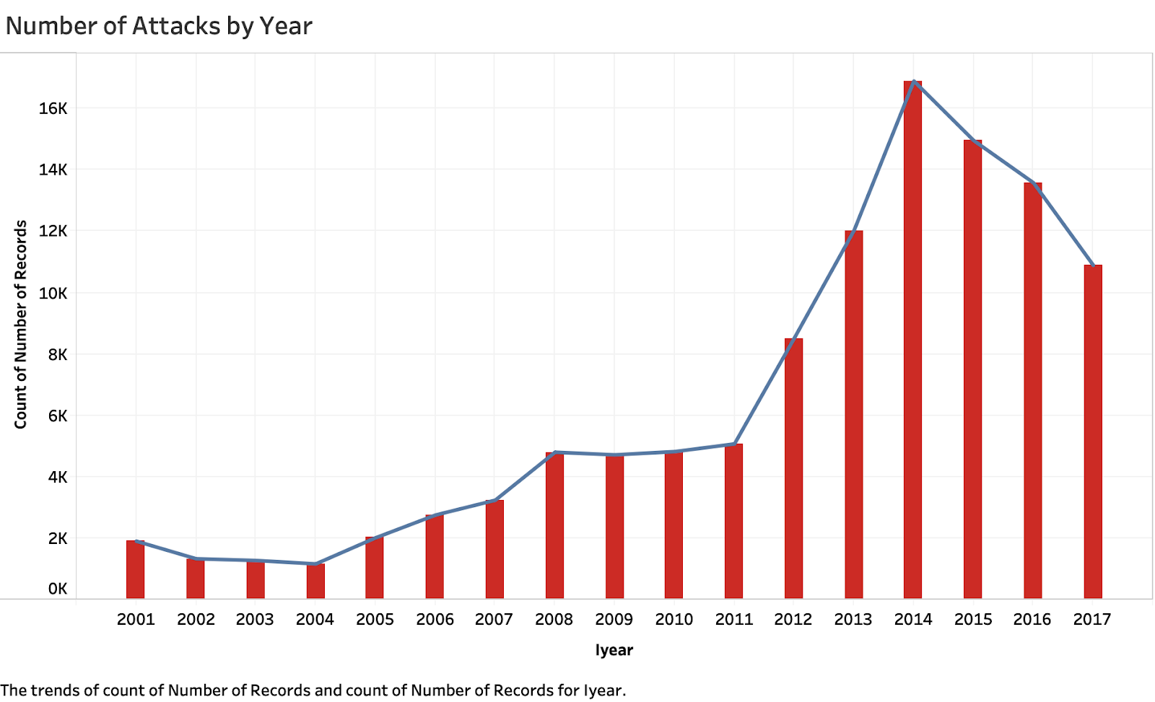
ANALYSIS
Terrorism trend over the years
The number of terrorist attacks increased in 2012 and reached its peak in 2014.
The surge in 2014 was largely due to increased activity of groups like Islamic state in Iraq and Boko Haram in Nigeria.
Civil war in Syria also spurred worldwide terrorism attacks.
Notes:
Source: https://www.bbc.com/news/world-us-canada-33206784

Slide 7
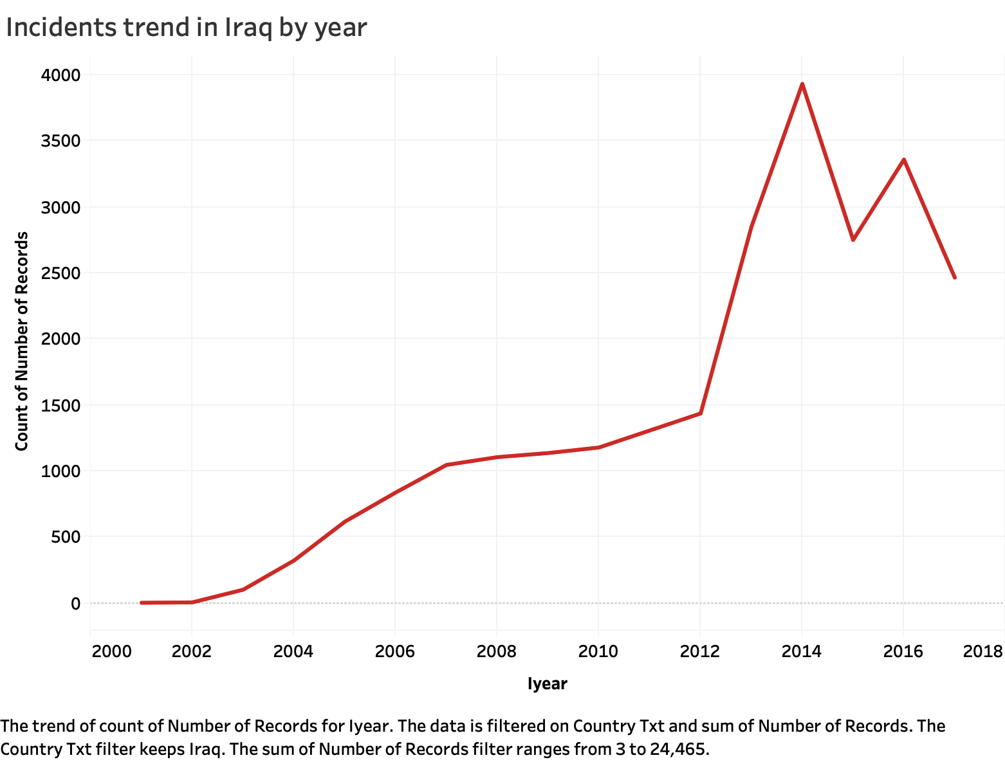
Analysis on Iraq
Since Iraq had the most number of incidents, we decided to analyze the country’s trend over the years.
The peak in 2014 could be because of the Iraqi Civil War which continued till 2017.
Notes:
Source: https://en.wikipedia.org/wiki/Iraqi_Civil_War_(2014%E2%80%932017)

Slide 8
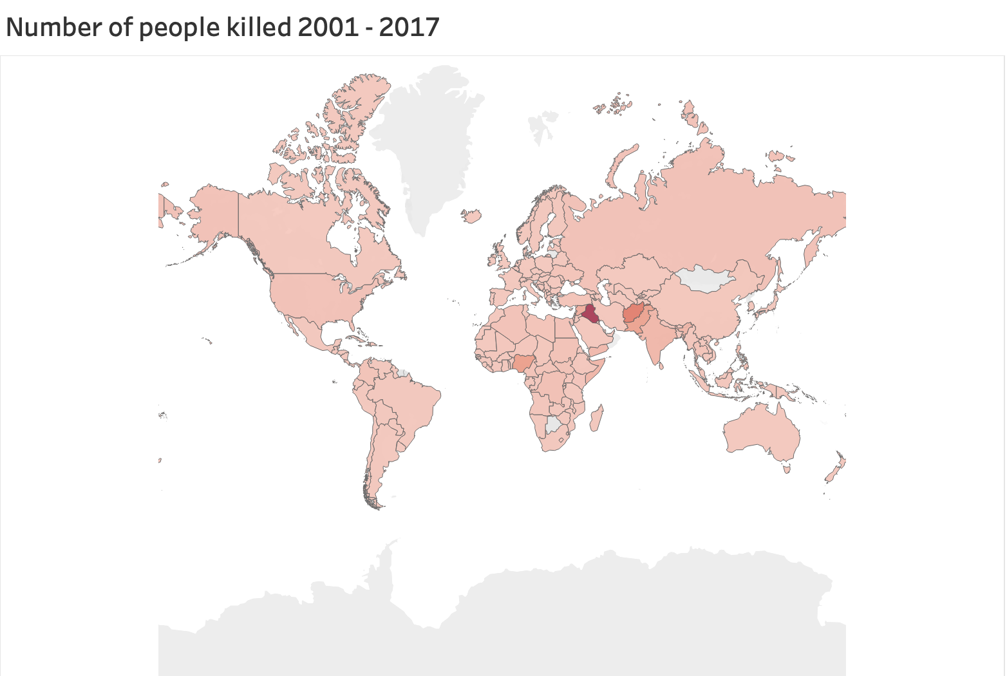
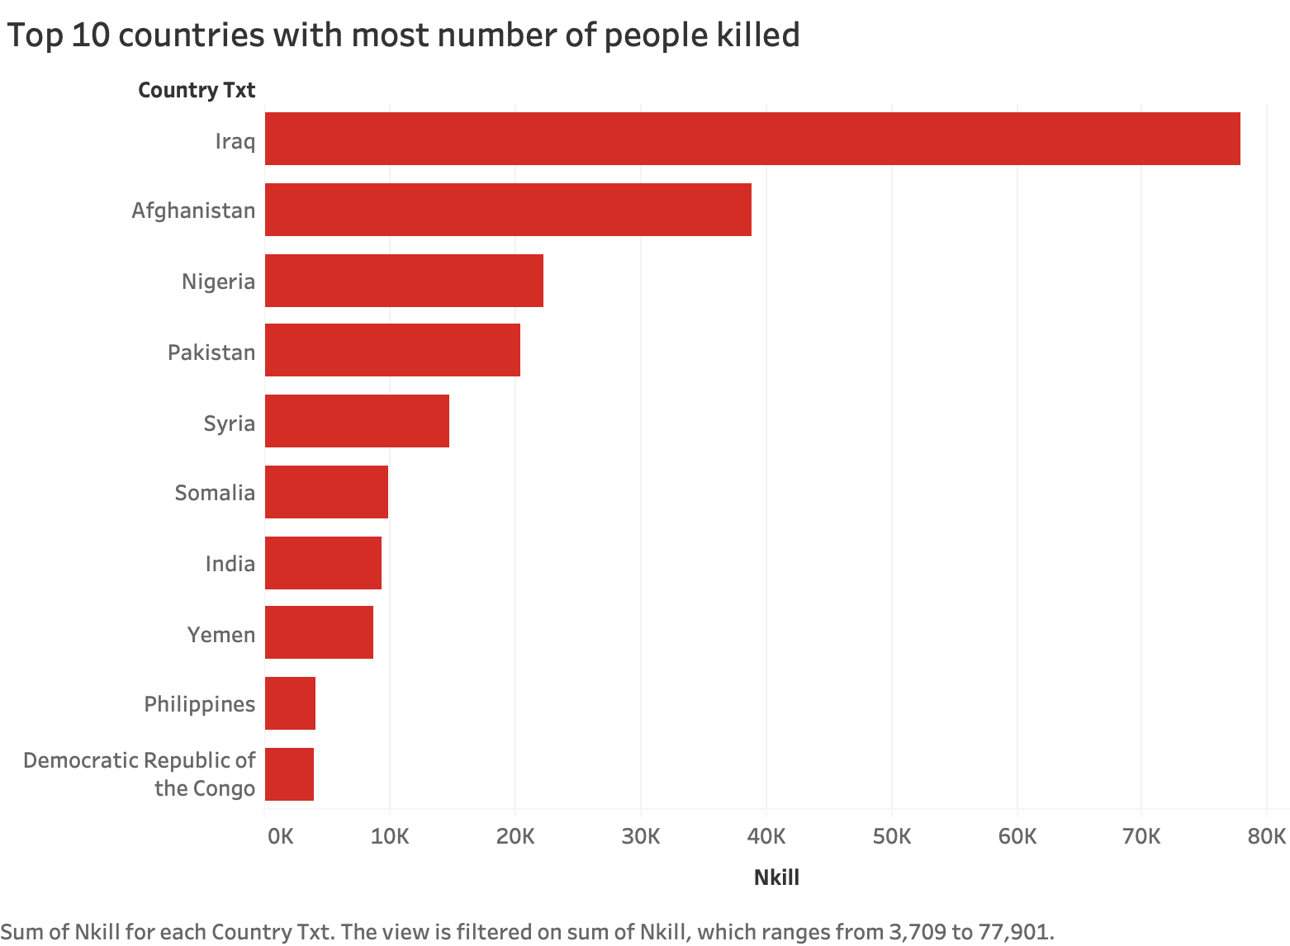
Total Fatalities
267061
Top 5 countries were responsible for 65.22% of the deaths
Notes:
Total = 267061
Iraq = 77901
Afghan = 38917
Nigeria = 22239
Pakistan = 20435
Syria = 14707
Top 5 : 65.22%

Slide 9
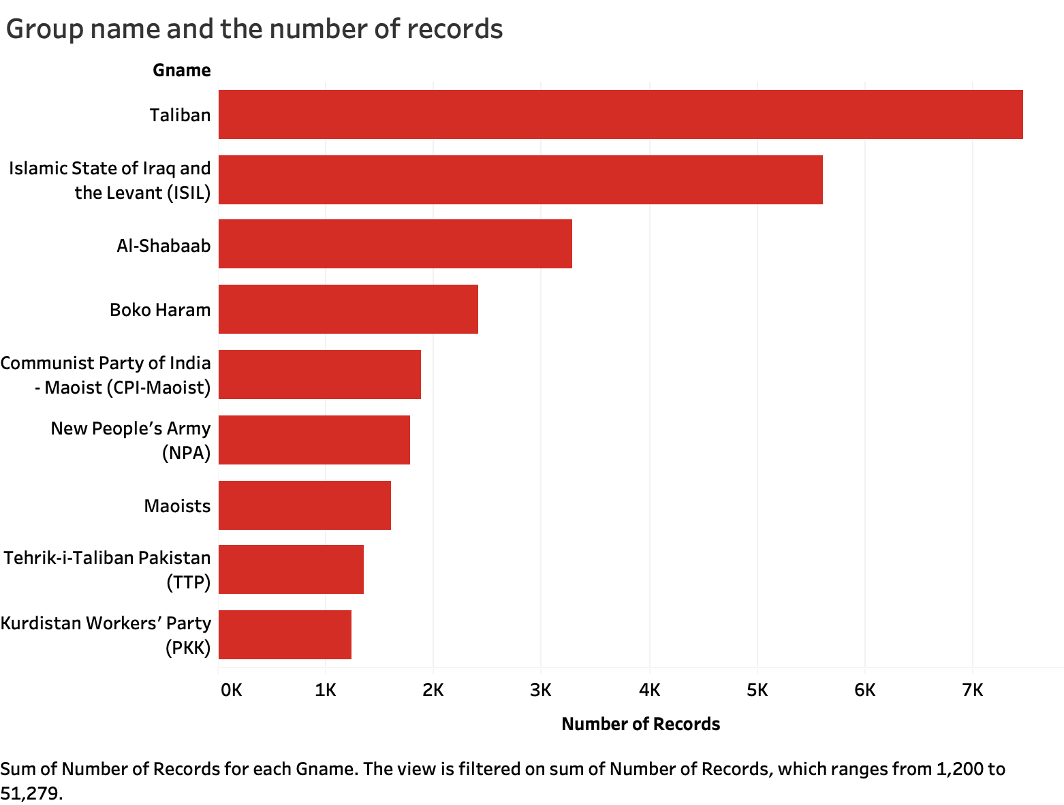
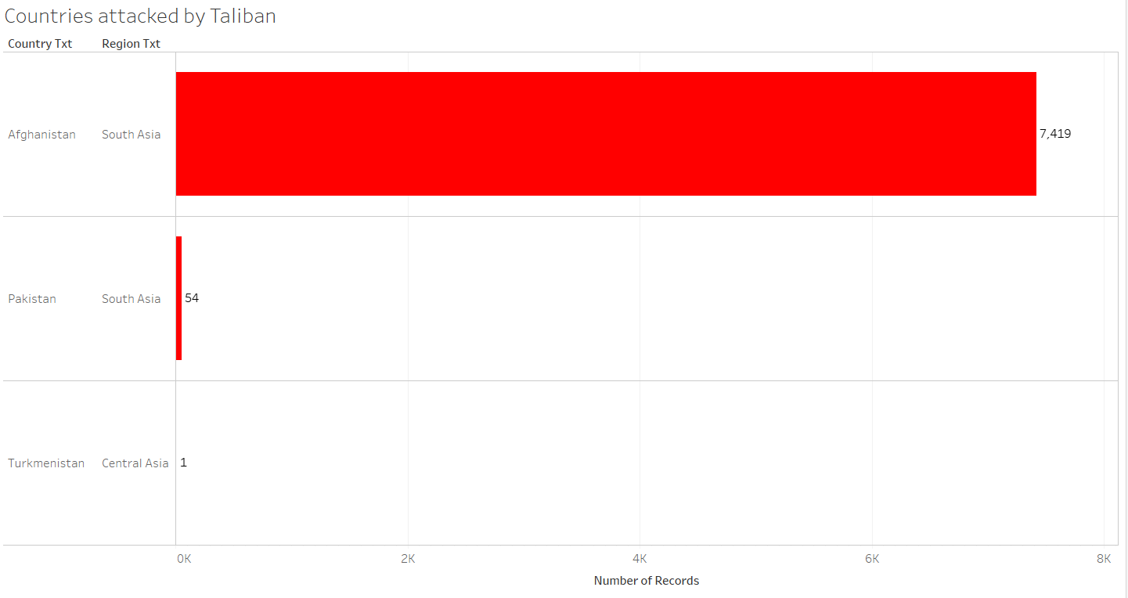
The groups that were most active between 2001 and 2017
Taliban was involved in 7474 attacks. All of their attacks were on South Asian countries of Afghanistan(7419) and Pakistan(54).

Slide 10
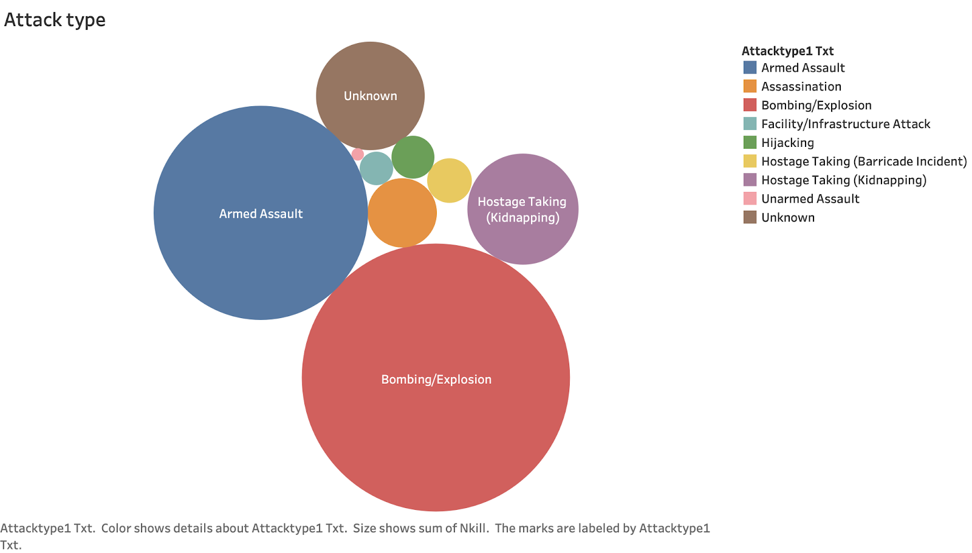
Common attack types
Bombing/Explosion is seen as a prevalent type of attack as it increases the available firepower of terrorists who are usually weaker than their targets as well as giving them publicity necessary to attract sympathizers to their cause.
Notes:
Source: https://en.wikipedia.org/wiki/Tactics_of_terrorism#Bombings

Slide 11
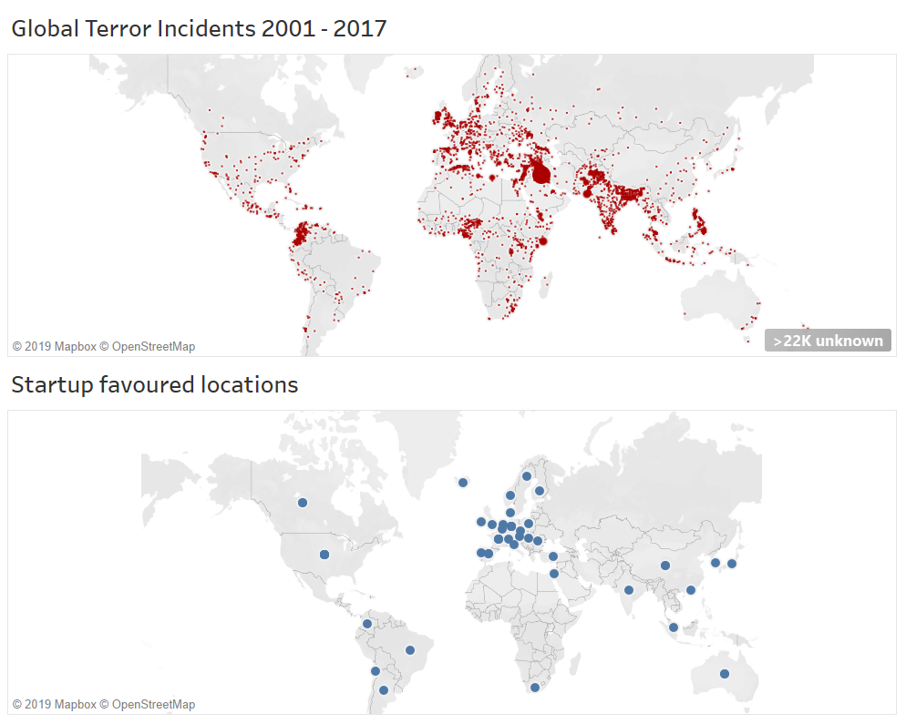
Use case - 50 best startup cities
50 best startup cities in 2019 as suggested by Valuer.
Startup cities fall in regions with comparatively low terrorist activities
Limitation: we have limited resolution data for startup and it has lead to a situation where a country as big as the USA has only one data point for startup favored location

Slide 12
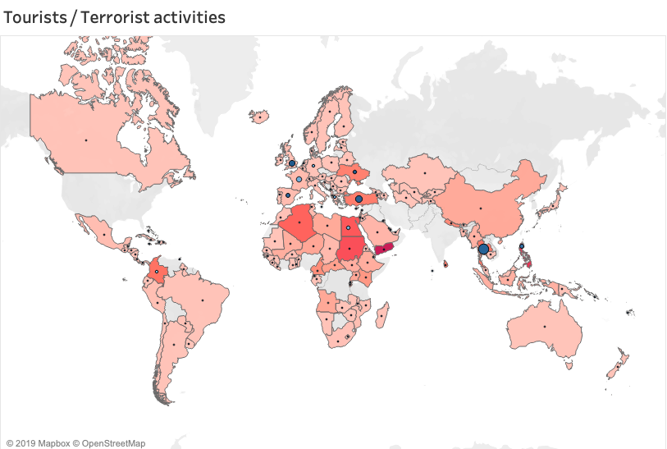
Use case - Tourist flows
We used Tourist/visitor arrivals and tourism expenditure data from UN data.
Heat map shows the no. of people killed by terrorist activities and circles shows the number of tourists to these countries.
Given the scope of this assignment the below analysis is very crude (for instance we have not filtered by years), however this exercise exemplifies the breadth of the use cases and corresponding stakeholders
Notes:
Source: https://data.un.org/

Slide 13
Trends:
Data shows terrorism activities peaked in 2014. There is clear link to countries like Iraq - civil war
Use cases:
Individuals interested in the risk associated with their business could refer to the database to run a risk analysis for the region of interest.
Scholars, researchers, analysts, journalists can use our analysis.
CONCLUSION

Slide 14
Github Link:
https://github.com/kanishk307/Global-Terrorism-Dataset-INFM600
Quick Links:
Presentation: https://github.com/kanishk307/Global-Terrorism-Dataset-INFM600/tree/master/Presentation
R Code: https://github.com/kanishk307/Global-Terrorism-Dataset-INFM600/tree/master/Code
Dataset: https://github.com/kanishk307/Global-Terrorism-Dataset-INFM600/tree/master/Dataset
Report: https://github.com/kanishk307/Global-Terrorism-Dataset-INFM600/tree/master/Report
Proposal: https://github.com/kanishk307/Global-Terrorism-Dataset-INFM600/tree/master/Proposal
Tableau: https://github.com/kanishk307/Global-Terrorism-Dataset-INFM600/tree/master/Tableau
Resources

